Slide 1

Department of Electronics and Communication Engineering
SWARM of UAV’S based on FSO using DCSK
Students Name and Roll Numbers:
E.Kavya-218T1A0462
M. Naga Sravani-218T1A0486
K.Kesava-218T1A0470
D.Anand-218T1A0461
Name of the Guide:
Md. Ayesha Shahanaz

Slide 2
Contents
Abstract
Introduction
Literature Survey
Problem Statement
Objective
Proposed technique
Results
Future Scope
Conclusion
References

Slide 3
Abstract
A secure and high-speed communication system is developed for UAV swarms using Free-Space Optical (FSO) technology with Differential Chaos Shift Keying (DCSK) modulation. Through MATLAB simulations, the system demonstrates improved performance in terms of BER and SNR, even under atmospheric disturbances. The design ensures scalability and robustness, supporting future UAV networks with machine learning and hybrid communication frameworks for critical applications like defense and disaster management.

Slide 4
Introduction
In modern wireless communication, Free-Space Optical (FSO) communication is gaining popularity due to its high data rates, security, and immunity to radio frequency (RF) interference.
Unmanned Aerial Vehicles (UAVs) form a swarm to enhance coverage, connectivity, and flexibility in dynamic environments such as military operations, disaster recovery, and remote sensing.
The Differential Chaos Shift Keying (DCSK) modulation technique is used in FSO communication to improve performance in harsh conditions by providing better resistance against noise and fading.
This project investigates the Bit Error Rate (BER) performance of a UAV swarm-based FSO communication system using DCSK under various atmospheric turbulence conditions.
Introduction to UAV Swarms

Slide 5
Literature Survey
S.no. | Title of the paper | Author’s Name | Year of Publication | Observations
1. | Performance Analysis of UAV-assisted FSO Communication Systems | Sharma et al. | 2022 | Improves link reliability and coverage, mitigates path loss, but sensitive to alignment and turbulence.
2. | Multi-hop FSO Relaying for Extended Coverage | Lee & Kim | 2021 | Enhances transmission range, reduces atmospheric impact, requires precise UAV alignment.
3. | DCSK Modulation for Robust FSO Communication | Gupta et al. | 2023 | Provides robustness to fading, supports non-coherent detection, BER performance affected under strong turbulence
4. | Analysis of Serial Relaying in UAV-assisted FSO | Zhang et al. | 2020 | Serial relay improves end-to-end BER performance under moderate turbulence, less adaptable to dynamic environments
5 | Hovering UAV-based FSO using DCSK for Reliable Communication | Current Proposed Work | 2025 | Combines DCSK with serial relaying to mitigate turbulence, pointing errors, and hovering fluctuations, improves overall system performance

Slide 6
Problem Statement
FSO faces challenges due to:
Atmospheric Turbulence (Weak, Moderate, Strong)
Signal Attenuation & Noise
Goal of the Project:
To analyze Bit Error Rate (BER) performance of FSO-DCSK under different turbulence conditions and M values.

Slide 7
Objective
Develop a secure and reliable communication system for a swarm of UAVs.
Use Free-Space Optical (FSO) communication to achieve high-speed, interference-free data transfer.
Implement Differential Chaos Shift Keying (DCSK) modulation for improved security and noise resistance.
Overcome challenges such as atmospheric turbulence, alignment issues, and data security.
Simulate and analyze the system performance using MATLAB, focusing on metrics like Bit Error Rate (BER) and Signal-to-Noise Ratio (SNR).

Slide 8
Proposed Technique
The proposed technique aims to enhance the communication efficiency and reliability of a swarm of UAVs by integrating Free Space Optical (FSO) communication with Differential Chaos Shift Keying (DCSK) modulation, supported by a serial relay system.
Swarm of UAVs: Multiple UAVs collaboratively form a dynamic network, providing flexible and scalable communication coverage, especially in mission-critical or remote operations.
Free Space Optical Communication: Utilizes laser-based data transmission, offering high-speed, secure, and interference-free communication, ideal for UAV environments.
Serial Relay System: Each UAV acts as a relay node, effectively extending the communication range and improving overall system reliability by reducing path loss and atmospheric distortion.
Differential Chaos Shift Keying (DCSK): A robust chaos-based modulation technique that ensures better noise immunity and security. It uses non-coherent detection, eliminating the need for complex channel estimation while improving Bit Error Rate (BER) performance.
Analytical and Simulation Validation: End-to-end BER expressions are derived, and simulation results are compared with analytical findings to confirm the improved performance of the system.

Slide 9
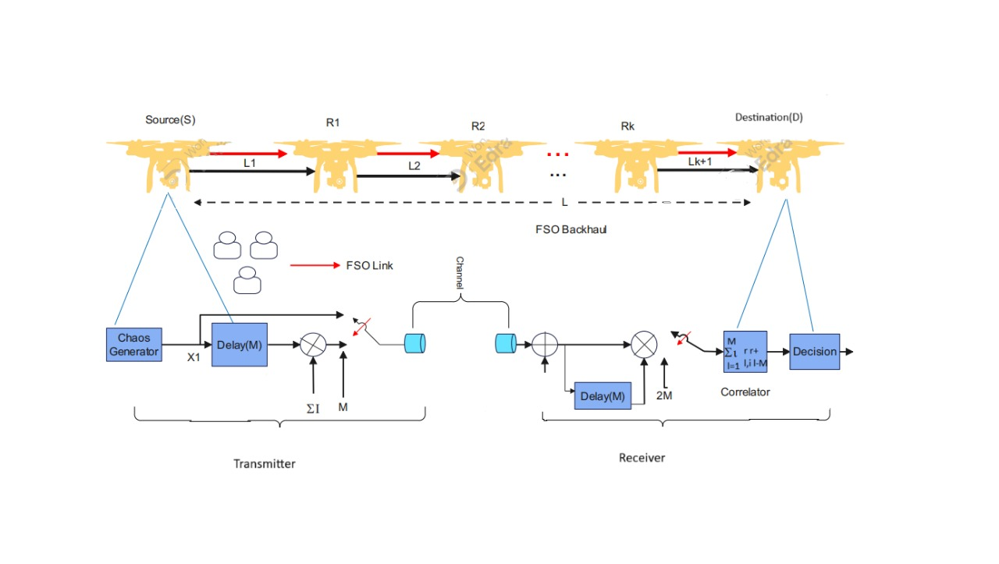
System Model

Slide 10
UAV Swarm Communication
Source (S):The starting UAV that transmits data through an FSO link.
Relays (R1, R2, ..., Rk): Intermediate UAVs that amplify and forward the signal.
2. Transmitter Section
Chaos Generator: Generates a chaotic signal used for DCSK modulation, ensuring better resistance to noise and interference.
Multiplier (ΣI): Modulates the data using the chaotic signal.
3. FSO Channel
The signal propagates through the FSO channel, which is affected by atmospheric turbulence, path loss, and weather conditions (fog, rain, etc.).
Optical relays (intermediate UAVs) may amplify and forward the signal to extend the range.
4. Receiver Section
Optical Receiver: Captures the incoming optical signal and converts it back into an electrical signal.
Decision Block: Determines the received bit based on the correlation result.

Slide 11

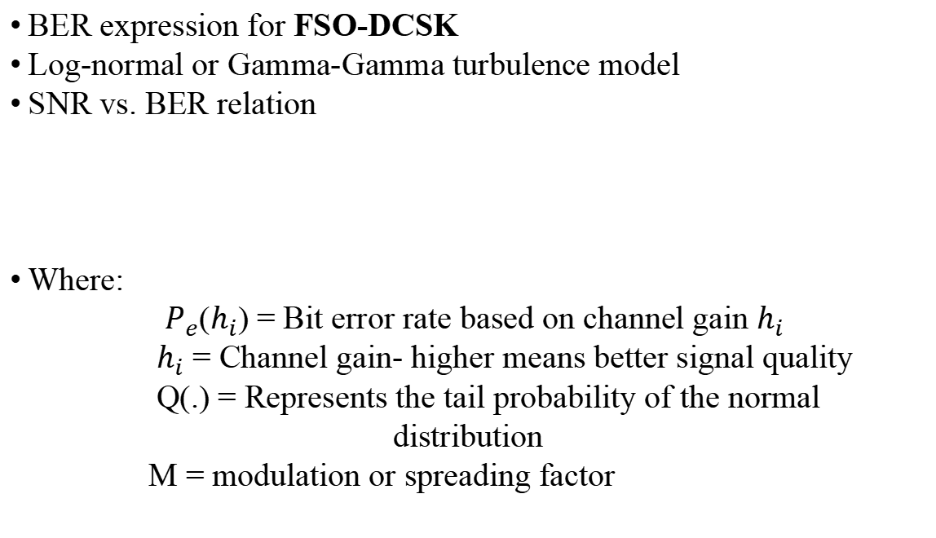
Mathematical Model
BER expression for FSO-DCSK
Log-normal or Gamma-Gamma turbulence model
SNR vs. BER relation
Where:
$P_{e}$($h_{i}$) = Bit error rate based on channel gain $h_{i}$
$h_{i}$ = Channel gain- higher means better signal quality
Q(.) = Represents the tail probability of the normal distribution
M = modulation or spreading factor

Slide 12
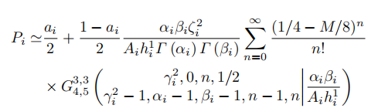
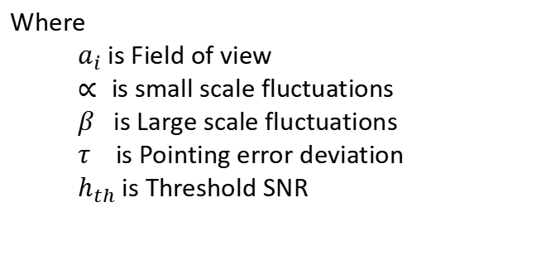
Mathematical Expressions for UAV based FSO System:
Where
$a_{i}$ is Field of view
$∝$is small scale fluctuations
$β$ is Large scale fluctuations
$τ$ is Pointing error deviation
$h_{th}$ is Threshold SNR

Slide 13
Simulation Setup
Simulation Tool: MATLAB
Parameters Used:
SNR range: 15 dB to 50 dB
M values: 4, 20, 40
Different turbulence conditions
Performance Metric: BER vs. SNR

Slide 14
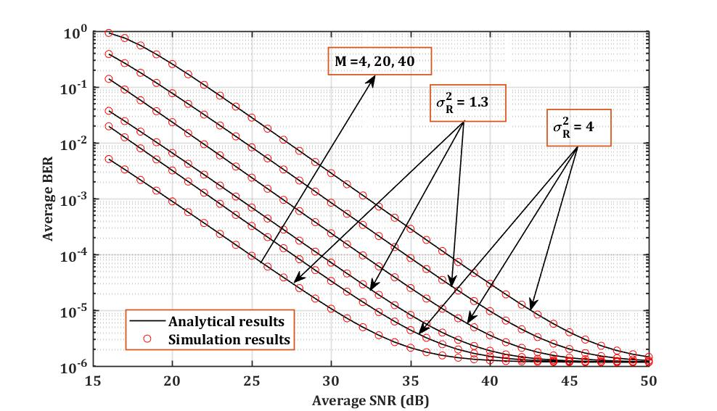
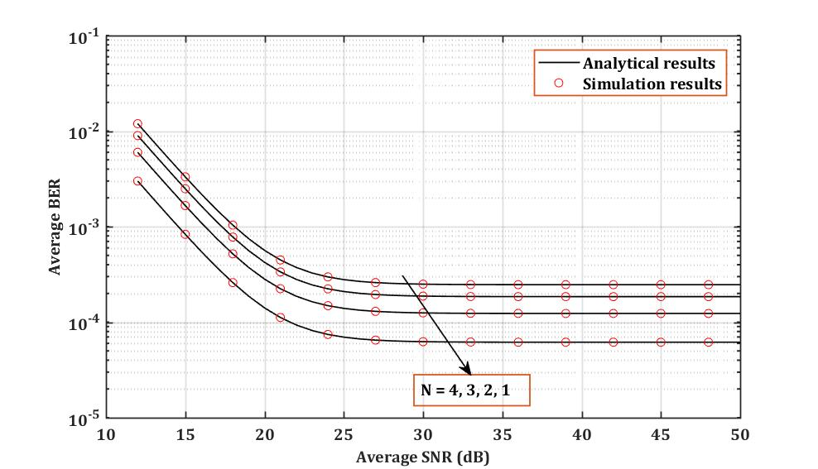
Results and Graphs

Slide 15
Higher SNR leads to lower BER, improving communication reliability.
Smaller FOV results in better BER performance, as it reduces noise and interference.
The analytical model closely matches the simulation results, proving its effectiveness in predicting system behavior.
Higher M values improve performance
Strong turbulence leads to higher BER
Increasing M improves BER but increases complexity
This analysis helps in optimizing FSO system parameters for enhanced performance in real-world conditions.

Slide 16
Conclusion
In this project, we investigated the performance of a Swarm of UAVs (Unmanned Aerial Vehicles) communicating via Free-Space Optical (FSO) links using Differential Chaos Shift Keying (DCSK) modulation. The proposed system leverages:
UAV Swarm communication using FSO-DCSK is feasible but requires turbulence mitigation.
FSO-DCSK is effective for secure FSO communication
BER performance improves with higher M values

Slide 17
Future Scope
In the future, the system can be enhanced by integrating AI for autonomous swarm control and dynamic routing. Hybrid FSO-RF communication will improve reliability under bad weather. Advanced error correction, hardware miniaturization, and better power efficiency will make it suitable for small UAVs.
Security improvements and scaling to larger UAV networks will expand applications like disaster management and surveillance. Finally, real-world testing will validate the system’s performance in practical environments.

Slide 18
REFERENCES
G. Narang, M. Aggarwal, H. Kaushal, S. Ahuja, Error Probability analysis of FSO communication system using differential chaos shift keying, in: 2018 5th International Conference on Signal Processing and Integrated Networks, SPIN, IEEE, Noida, India, 2018.
Dabiri, Mohammad Taghi, Himan Savojbolaghchi, and Seyed Mohammad Sajad Sadough. “On the ergodic capacity of ground-to-UAV free-space optical communications.” 2019 2nd West Asian colloquium on Optical Wireless Communications (WACOWC). IEEE, 2019.
Ratnam, Nallagonda Vijaya. Performance Analysis and Enhancement of Unmanned Aerial Vehicle Based Free Space Optical Communication System. Diss. National Institute of Technology Karnataka, Surathkal, 2022.
Nallagonda, Vijaya Ratnam, and Prabu Krishnan. “Bit error rate analysis of polarization shift keying based free space optical link over different weather conditions for inter unmanned aerial vehicles communications.” Optical and Quantum Electronica 53.9 (2021): 538.
Dabiri, Mohammad Taghi and Rezaee, Mohsen and Ansari, Imran Shafique. “Channel Modeling for UAV-based Optical Wireless Links with Nonzero Boresight Pointing Errors.” arXiv preprint arXiv:2004.10071,2020.

Slide 19
Thank You

